Slide 1

Nimrat Pal Kaur
Data Analyst

Slide 2

Project - Rockbuster Stealth
Overview
Rockbuster Stealth LLC, a global movie rental company, is shifting from traditional brick-and-mortar stores to an online streaming platform to compete with major players like Netflix and Amazon Prime. As a Data Analyst in the Business Intelligence team, my role was to support this transition using data-driven insights.
I worked with Rockbuster’s historical data—covering films, customers, rentals, and payments—by loading it into a PostgreSQL database and performing a series of SQL analyses. The goal was to answer key strategic questions, such as understanding customer behavior, identifying high-value markets, and analysing film performance. All insights were transformed into clear visualizations and actionable recommendations for senior management to guide Rockbuster’s 2020 online launch strategy.

Slide 3
Problem
Which movies, customer segments, and regions generate the most value, and how can these insights guide Rockbuster's online streaming launch strategy?
Goal
Analyze Rockbuster’s existing data—films, customers, payments, and rentals—to uncover insights that will guide strategic decisions for their 2020 online streaming rollout.
Role: Data Analyst
Project Scale: 2 weeks
Primary Stakeholder: CareerFoundry
Tools Used
SQL
Tableau
Google Slides

Slide 4

Key Questions and Objectives
Which movies contributed the most/least to revenue gain?
What was the average rental duration for all videos?
Which countries are Rockbuster customer based in?
Where are customers with a high lifetime value based?
Do sales figures vary between geographic regions?

Slide 5
My Analytical Journey
Data Setup
To answer the key questions, the data was loaded into PostgreSQL database and I used SQL for comprehensive data analysis.
Data Cleaning & Exploration
I identified missing values, outliers and inconsistencies.
I used SQL joins and aggregations functions to uncover patterns hidden in the data.
Focus
The analysis focused on three critical areas: Movie Performance by Rating, Geographic Sales Distribution, and Revenue by Genre

Slide 6
Rental Statistics
Rental duration: 5 days
Rental rate: 2.98
Replacement cost: 19.98
Length: 115.27 minutes
Rental duration: 3 days
Rental rate: 0.99
Replacement cost: 9.99
Length: 46 minutes
Average
Minimum
Rental duration: 7 days
Rental rate: 4.99
Replacement cost: 29.99
Length: 185 minutes
Maximum

Slide 7
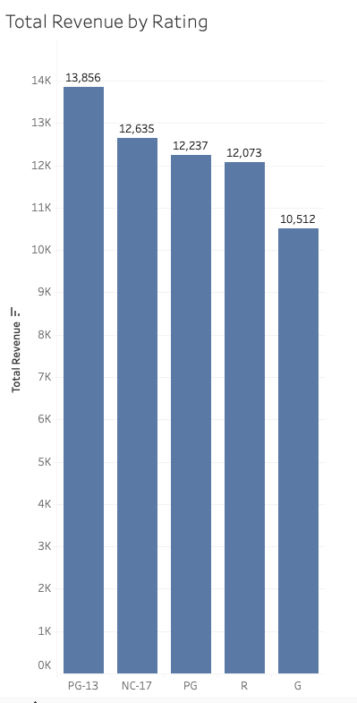
Insights & Analysis
Insight 1 - Movie Ratings Performance
Goal - To answer the question: "Which movies contributed the most/least to revenue gain?"
Process - In SQL, I joined four different tables (payments, rental, inventory and film. Then I calculated total revenue generated by all payments, grouped revenue for each specific film rating, and sorted revenue by highest to lowest.
Findings - In the given year, PG-13 content is the most profitable rating category for Rockbuster.
PG-13 movies generated the highest revenue: $13,856.
G-rated films generated the lowest revenue: $10,512.
How I showed - I used Tableau to create a simple bar chart so management could see the revenue for each rating category instantly.

Slide 8
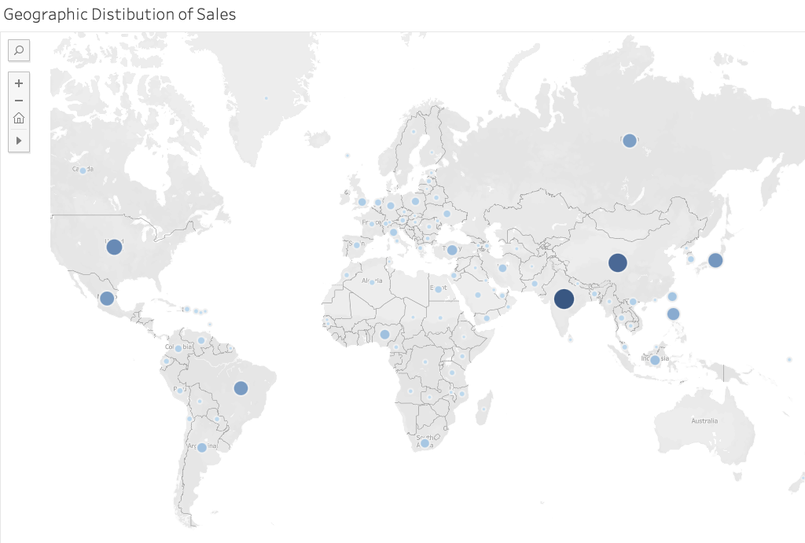
Insight 2 - Geographic Revenue Distribution
Goal - We needed to know if sales changed much across different countries and identify the most valuable customers.
Findings - Sales varied a lot by country. The top 5 countries that brought in the highest revenue were India, China, United States, Japan and Mexico.
Why it mattered - This showed us exactly where to focus our marketing and online launch efforts to get the biggest return.
My decision - To make this clear, I chose a geographic visualization. Seeing the names of the top countries made the recommendation easy to grasp.

Slide 9
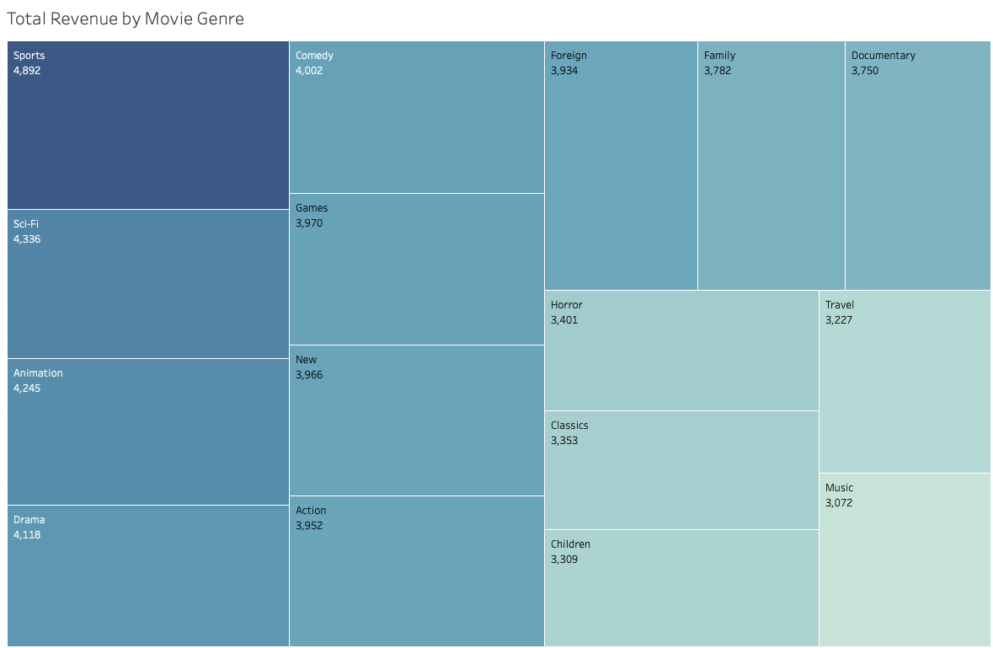
Insight 3 - Genre Revenue Trends
Goal - Pinpoint which movie genres generate the most revenue to guide future content deals.
Findings - The top three highest earnings are Sports, Sci-Fi, Animation. Genres like Music, Travel and Children earned the least.
How I showed - I used a chart called a Treemap. This chart uses size to show value, so the massive size of the Sports box made it immediately obvious that it was the dominant genre.

Slide 10

Summary and Final Solution
The analysis gave us solid answers to all the big questions, creating a simple, three-part plan for the 2020 online launch:
Content Strategy(What to Buy): Rockbuster needs to focus on buying more PG-13 rated movies and films in the Sports, Sci-Fi, and Animation genres. These movies bring in the most money , so focusing the budget here will give the company the biggest profits.
Market Strategy(Where to Focus): The most important countries are India, China, and the United States. These regions have the best, most loyal customers. We should launch targeted marketing and invest in infrastructure specifically in these three countries first.
Operational Strategy(How to Price): We learned that the average movie rental lasts 5 days. This is a key piece of information for setting up competitive subscription plans and pricing for the new streaming service.

Slide 11

Retrospective
👍 What Went Well?
The project's greatest success was delivering a clear, data-driven plan for the online shift. I organized the customer and film data, allowing to find the most pr
ofitable movie ratings (PG-13) and key countries (India, China, US). This provided a straightforward strategy for content buying and marketing.
🚫 Biggest Challenge
The initial analysis required significant effort to accurately connect revenue to specific genres and regions. Since the payment, rental, and film details were spread across many database tables, ensuring all the joins were correct for the final revenue totals was tricky and time-consuming.
👍 ⏭️ Future Steps
For future analysis, I need to look closely at whether our top genres sell well in all regions. I'd analyze if the most popular movies globally (Sports, Sci-Fi, Animation) are also the most popular in countries like India, China, and the U.S., or if tastes are different locally.
✨ Final Thoughts
I'm very proud that this analysis created a solid, measurable roadmap for success. It showed the company exactly where to spend money and where to focus efforts to become profitable in the new digital streaming world.

